Slide 1
Rule 5.00
PUTTING THE BALL IN PLAY

Slide 2
Rule 5.00
5.01 – To officially start a game, the umpire must call “Play.”
5.02 – To suspend the game, or create a dead ball situation, call “Time.”
5.03 – The pitcher shall deliver a pitch to the batter.
5.04 – The offense’s objective is to turn batters into runners and advance.
5.05 – The defense’s objective is to prevent runners and their advancement.
5.06 – When a runner touches all bases legally, they score one run.
5.07 – When 3 outs are made, switch sides.
5.08 – If a base coach intentionally interferes with a thrown ball, the runner is out.
Accidental contact with a thrown ball shall not be called interference.

Slide 3
Rule 5.00
5.09 – The ball is dead and runners advance one base or return to their base(s) without liability to be put out when:
A pitch hits the batter or their clothing in a legal position. (runners advance if forced)
Umpire interference of a catcher’s act of throwing. (runners return)
An illegal pitch/balk. (runners advance)
Illegally batted ball, fair or foul. (runners return)
An uncaught foul ball. (runners return)
A fair ball strikes a fielder*.
A fair ball strikes an umpire or runner before it touches an infielder, including the pitcher. (runner that gets hit is out)
A pitched ball lodges in the catcher’s/umpire’s mask or paraphernalia. (runners advance)
Jr/Sr baseball – Any legal pitch touches a runner trying to score. (runners advance)

Slide 4
Rule 5.00
5.10 – The ball is dead when the umpire calls “time.” The umpire shall call time when:
Weather, darkness, similar conditions make further play impossible. SAFETY FIRST
Light failure makes it difficult to follow the play.
An accident incapacitates a player or umpire.
For a homerun or an umpire award, a substitute may complete the play for the incapacitated player.
A manager requests time for a substitution or conference.
Note: 1 offensive timeout per inning.
The umpire wishes to examine the ball or consult with a manager.
A fielder, after catching a fly ball, falls into a dead ball area.
Note: If the fielder does not fall, do not kill play. Runners may advance at their own risk. The fielder can throw from the dead ball area.
When an umpire orders anyone removed from the playing field.
Except for light failure or an accident, do not call time during a play in progress.

Slide 5
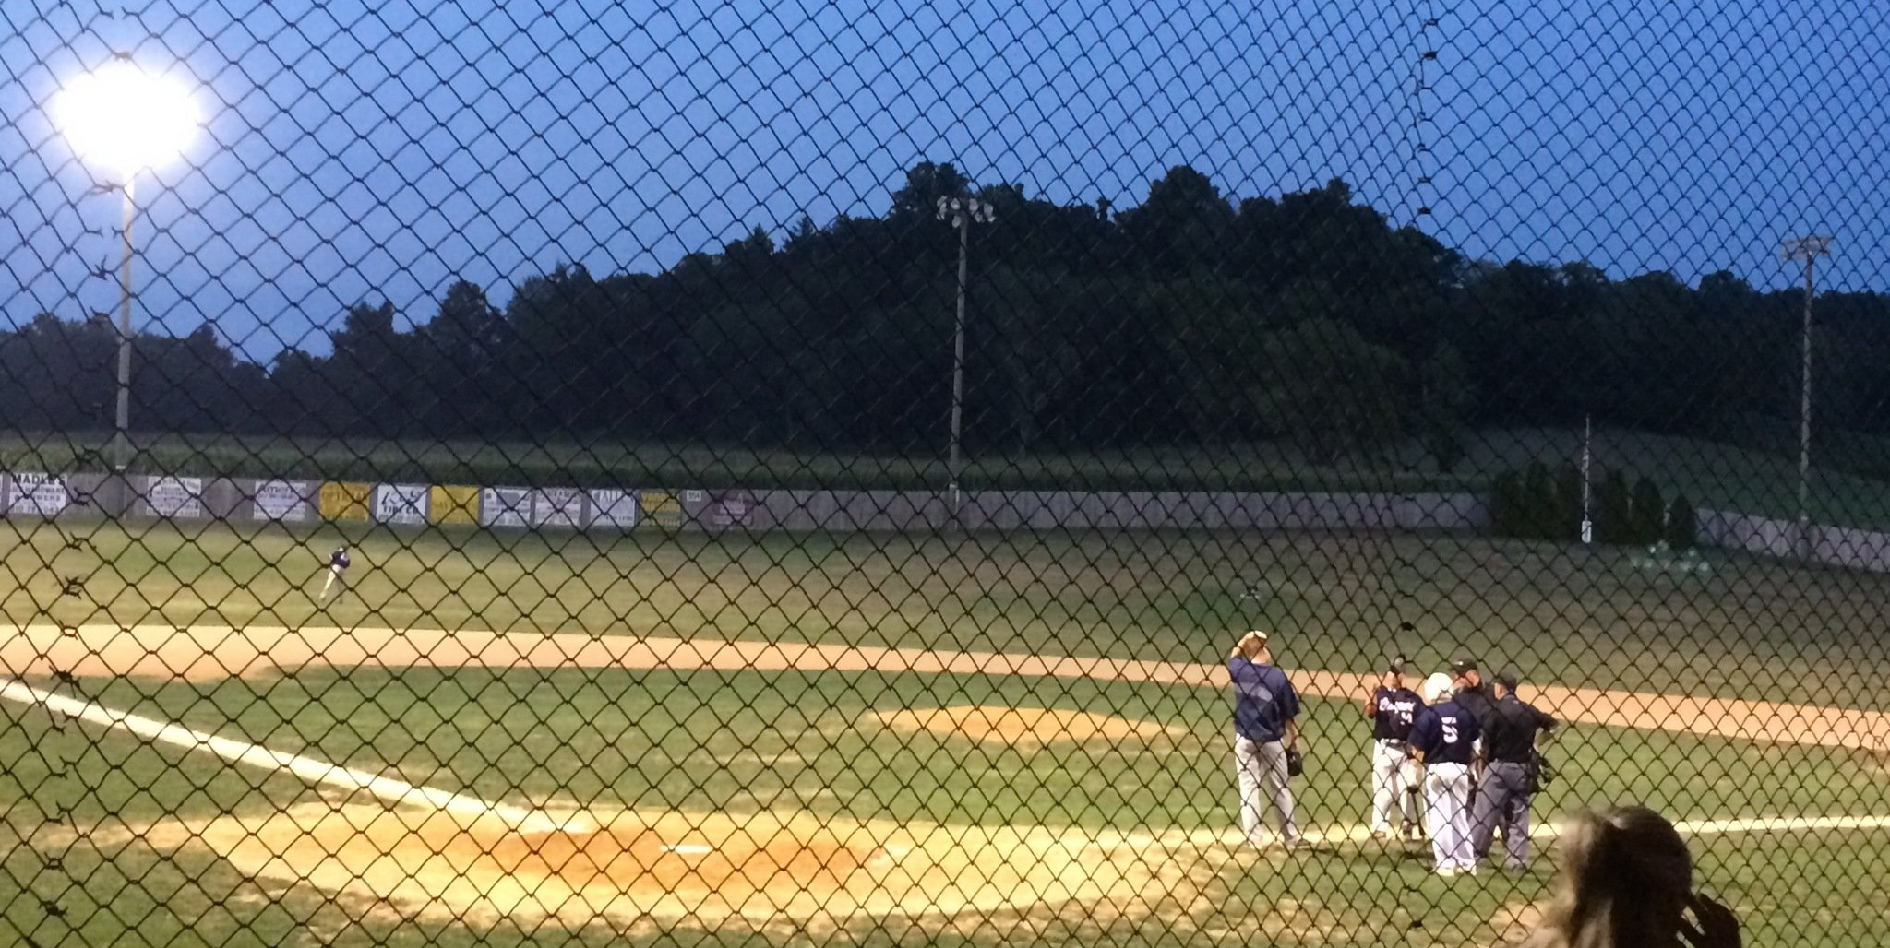
Light Failure Not the same as darkness.

Slide 6
Rule 5.00
5.11 – Play shall be resumed when:
The pitcher with possession of the ball takes position on the pitcher’s plate.
The batter is positioned in the batter’s box ready to hit.
The catcher is positioned in the catcher’s box ready to receive.

